Slide 1
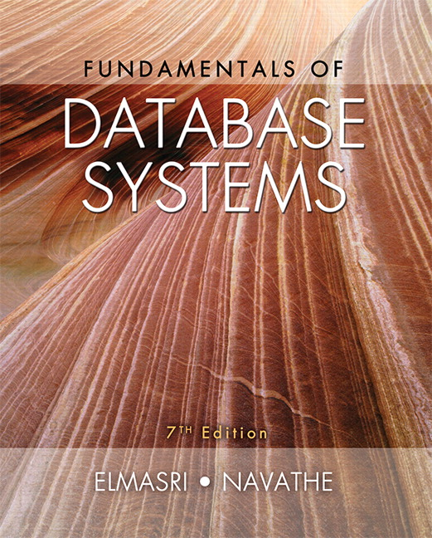

Slide 2
CHAPTER 23
Distributed Database Concepts

Slide 3
Introduction
Distributed computing system
Consists of several processing sites or nodes interconnected by a computer network
Nodes cooperate in performing certain tasks
Partitions large task into smaller tasks for efficient solving
Big data technologies
Combine distributed and database technologies
Deal with mining vast amounts of data

Slide 4
23.1 Distributed Database Concepts
What constitutes a distributed database?
Connection of database nodes over computer network
Logical interrelation of the connected databases
Possible absence of homogeneity among connected nodes
Distributed database management system (DDBMS)
Software system that manages a distributed database

Slide 5
Distributed Database Concepts (cont’d.)
Local area network
Hubs or cables connect sites
Long-haul or wide area network
Telephone lines, cables, wireless, or satellite connections
Network topology defines communication path
Transparency
Hiding implementation details from the end user

Slide 6
Transparency
Types of transparency
Data organization transparency
Location transparency
Naming transparency
Replication transparency
Fragmentation transparency
Horizontal fragmentation
Vertical fragmentation
Design transparency
Execution transparency

Slide 7
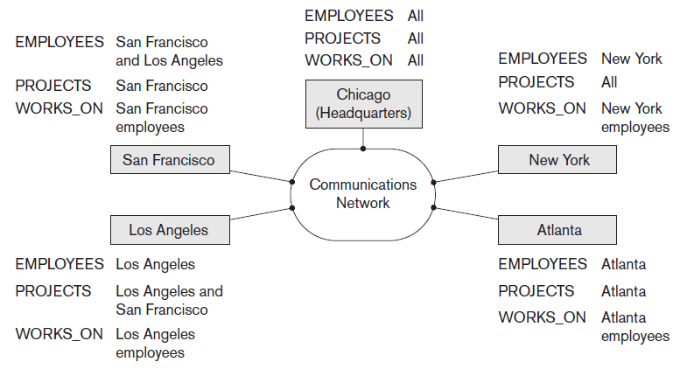
Distributed Databases
Figure 23.1 Data distribution and replication among distributed databases

Slide 8
Availability and Reliability
Availability
Probability that the system is continuously available during a time interval
Reliability
Probability that the system is running (not down) at a certain time point
Both directly related to faults, errors, and failures
Fault-tolerant approaches

Slide 9
Scalability and Partition Tolerance
Horizontal scalability
Expanding the number of nodes in a distributed system
Vertical scalability
Expanding capacity of the individual nodes
Partition tolerance
System should have the capacity to continue operating while the network is partitioned

Slide 10
Autonomy
Determines extent to which individual nodes can operate independently
Design autonomy
Independence of data model usage and transaction management techniques among nodes
Communication autonomy
Determines the extent to which each node can decide on sharing information with other nodes
Execution autonomy
Independence of users to act as they please

Slide 11
Advantages of Distributed Databases
Improved ease and flexibility of application development
Development at geographically dispersed sites
Increased availability
Isolate faults to their site of origin
Improved performance
Data localization
Easier expansion via scalability
Easier than in non-distributed systems

Slide 12
23.2 Data Fragmentation, Replication, and Allocation Techniques for Distributed Database Design
Fragments
Logical units of the database
Horizontal fragmentation (sharding)
Horizontal fragment or shard of a relation is a subset of the tuples in that relation
Can be specified by condition on one or more attributes or by some other method
Groups rows to create subsets of tuples
Each subset has a certain logical meaning

Slide 13
Data Fragmentation (cont’d.)
Vertical fragmentation
Divides a relation vertically by columns
Keeps only certain attributes of the relation
Complete horizontal fragmentation
Apply UNION operation to the fragments to reconstruct relation
Complete vertical fragmentation
Apply OUTER UNION or FULL OUTER JOIN operation to reconstruct relation

Slide 14
Data Fragmentation (cont’d.)
Mixed (hybrid) fragmentation
Combination of horizontal and vertical fragmentations
Fragmentation schema
Defines a set of fragments that includes all attributes and tuples in the database
Allocation schema
Describes the allocation of fragments to nodes of the DDBS

Slide 15
Data Replication and Allocation
Fully replicated distributed database
Replication of whole database at every site in distributed system
Improves availability remarkably
Update operations can be slow
Nonredundant allocation (no replication)
Each fragment is stored at exactly one site

Slide 16
Data Replication and Allocation (cont’d.)
Partial replication
Some fragments are replicated and others are not
Defined by replication schema
Data allocation (data distribution)
Each fragment assigned to a particular site in the distributed system
Choices depend on performance and availability goals of the system

Slide 17
Example of Fragmentation, Allocation, and Replication
Company with three computer sites
One for each department
Expect frequent access by employees working in the department and projects controlled by that department
See Figures 23.2 and 23.3 in the text for example fragmentation among the three sites

Slide 18
Company Relational DB Schema

Slide 24
23.6 Types of Distributed Database Systems
Factors that influence types of DDBMSs
Degree of homogeneity of DDBMS software
Homogeneous
Heterogeneous
Degree of local autonomy
No local autonomy
Multidatabase system has full local autonomy
Federated database system (FDBS)
Global view or schema of the federation of databases is shared by the applications

Slide 25
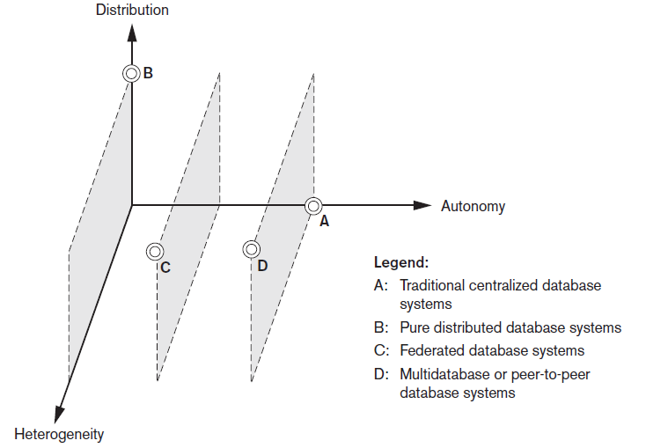
Classification of Distributed Databases
Figure 23.6 Classification of distributed databases

Slide 26
Types of Distributed Database Systems (cont’d.)
Federated database management systems issues
Differences in data models
Differences in constraints
Differences in query languages
Semantic heterogeneity
Differences in meaning, interpretation, and intended use of the same or related data

Slide 27
Types of Distributed Database Systems (cont’d.)
Design autonomy allows definition of the following parameters
The universe of discourse from which the data is drawn
Representation and naming
Understanding, meaning, and subjective interpretation of data
Transaction and policy constraints
Derivation of summaries

Slide 28
Types of Distributed Database Systems (cont’d.)
Communication autonomy
Decide whether to communicate with another component DBS
Execution autonomy
Execute local operations without interference from external operations by other component DBSs
Ability to decide order of execution
Association autonomy
Decide whether and how much to share its functionality and resources

Slide 29
23.7 Distributed Database Architectures
Parallel versus distributed architectures
Types of multiprocessor system architectures
Shared memory (tightly coupled)
Shared disk (loosely coupled)
Shared-nothing

Slide 30
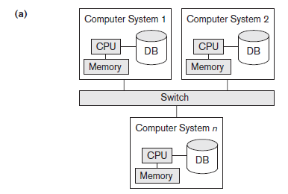
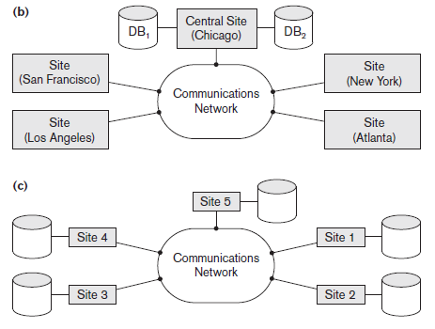
Database System Architectures
Figure 23.7 Some different database system architectures (a) Shared-nothing architecture (b) A networked architecture with a centralized database at one of the sites (c) A truly distributed database architecture

Slide 31
General Architecture of Pure Distributed Databases
Global query compiler
References global conceptual schema from the global system catalog to verify and impose defined constraints
Global query optimizer
Generates optimized local queries from global queries
Global transaction manager
Coordinates the execution across multiple sites with the local transaction managers

Slide 32
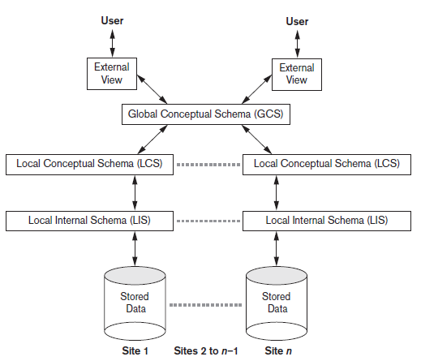
Schema Architecture of Distributed Databases
Figure 23.8 Schema architecture of distributed databases

Slide 33
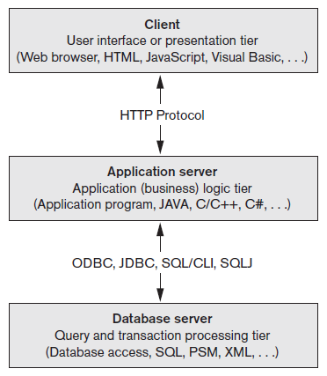
An Overview of Three-Tier Client/Server Architecture
Division of DBMS functionality among the three tiers can vary
Figure 23.10 The three-tier client/server architecture

Slide 34
23.8 Distributed Catalog Management
Centralized catalogs
Entire catalog is stored at one single site
Easy to implement
Fully replicated catalogs
Identical copies of the complete catalog are present at each site
Results in faster reads
Partially replicated catalogs
Each site maintains complete catalog information on data stored locally at that site

Slide 35
23.9 Summary
Distributed database concept
Distribution transparency
Fragmentation transparency
Replication transparency
Design issues
Horizontal and vertical fragmentation
Categorization of DDBMSs

